Slide 1
GOTV Training
Region Z
Cities/Towns, Counties, Regions
Click for Google Slides Version
Notes:
HOW TO USE THIS DECK:
This deck is intended for you to use in training your top volunteer leaders.
It is fairly detailed and goes deeper into the weeds than you would probably go with new or casual volunteers.
Make a copy and customize how you see fit.
You know your teams and turfs best – feel free to chop this up however you think is best.
You might add more detail in certain areas if you know that’s what your top vols wants.
You could also trim this down significantly and use it as a more light-weight GOTV training for more casual volunteers.
WELCOME:
Welcome everyone.

Slide 2
Agenda
State of the Race
The importance of scaling
Phases of GOTV
Data Operation & our persuasion universe
Voter Contact during the final stretch
Staging Locations
Volunteer recruitment

Slide 3



We are in the final stretch. What’s different?
Scale: There will be more volunteers, having more conversations, in more places than ever before.
Speed:
We need to be more efficient than ever before. We need to knock on more doors per packet and send high quality reports faster.
Structure:
We need to have clear lanes, tight schedules, good communication, and detailed reports to stay on track and hit big goals.
Notes:
KEY IDEA:
During the final stretch we will need to work at a bigger scale, with more speed, and be more organized than ever before.
Keep these things in mind throughout this training – they underlie everything about our strategy over the next XX days.

Slide 4
State of the Race

Slide 5
We Have Historic Candidates & Unprecedented Momentum
Wisconsin has had over 63,000 new online volunteer sign ups since July 21st.
Over 16,500 of them are new volunteers!
Everywhere Vice President Harris & Gov. Tim Walz go people show up!

Slide 6
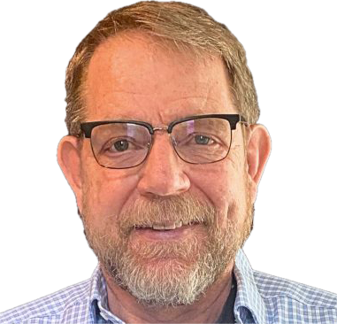
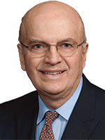
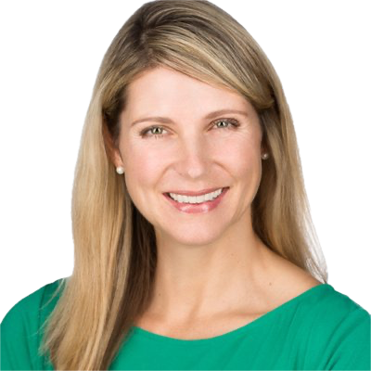
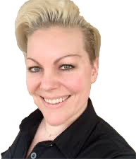
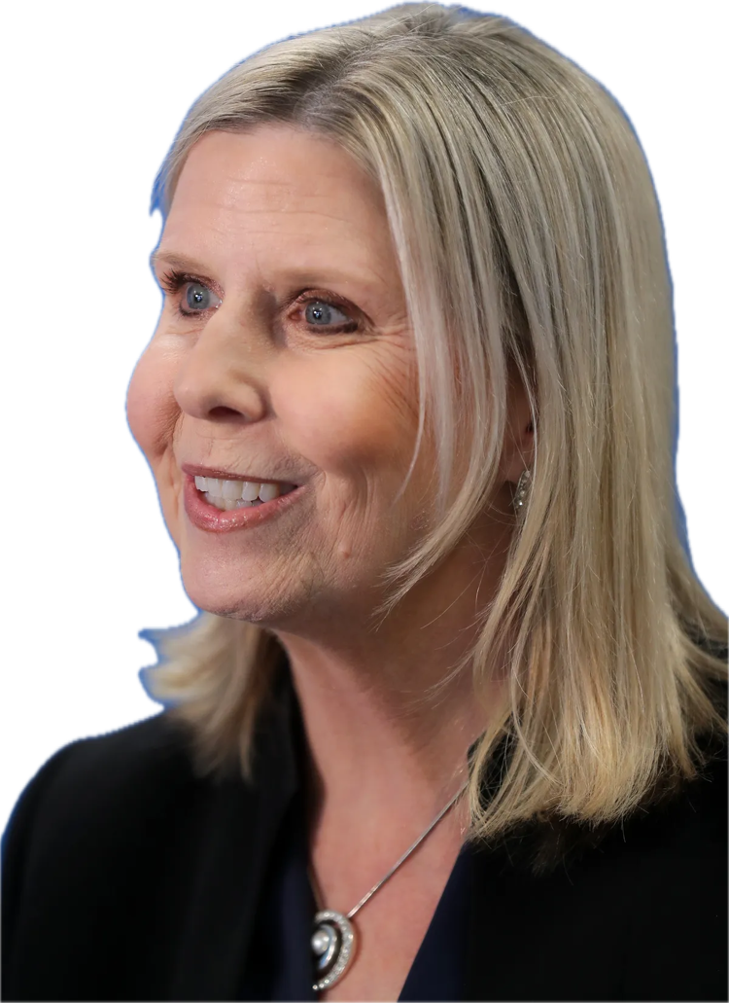
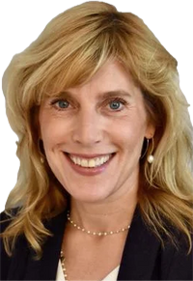

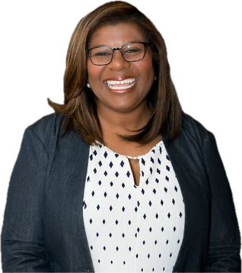
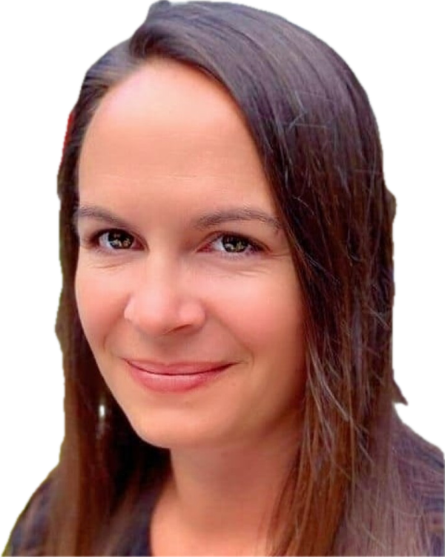
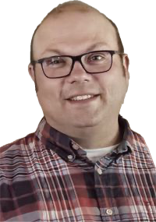
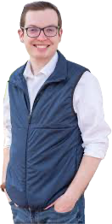
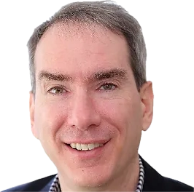
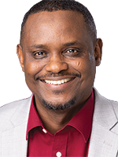
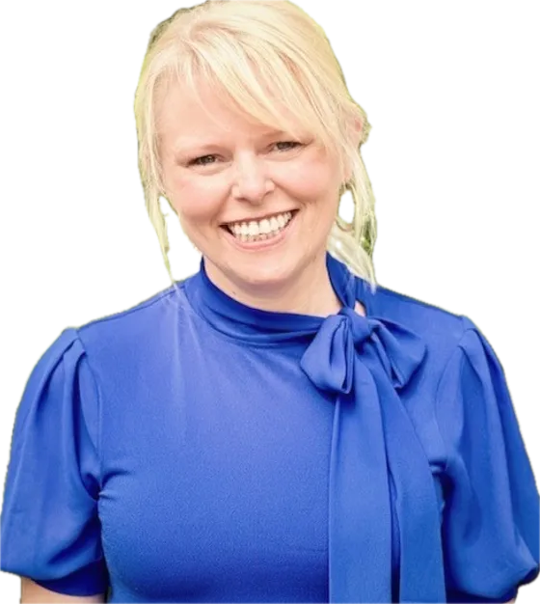
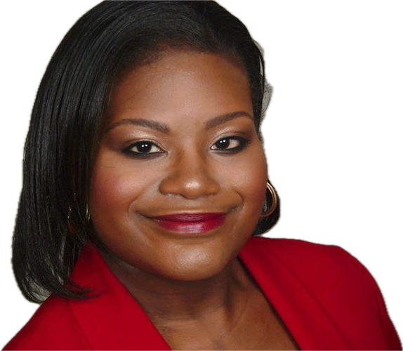
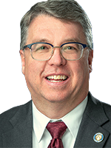
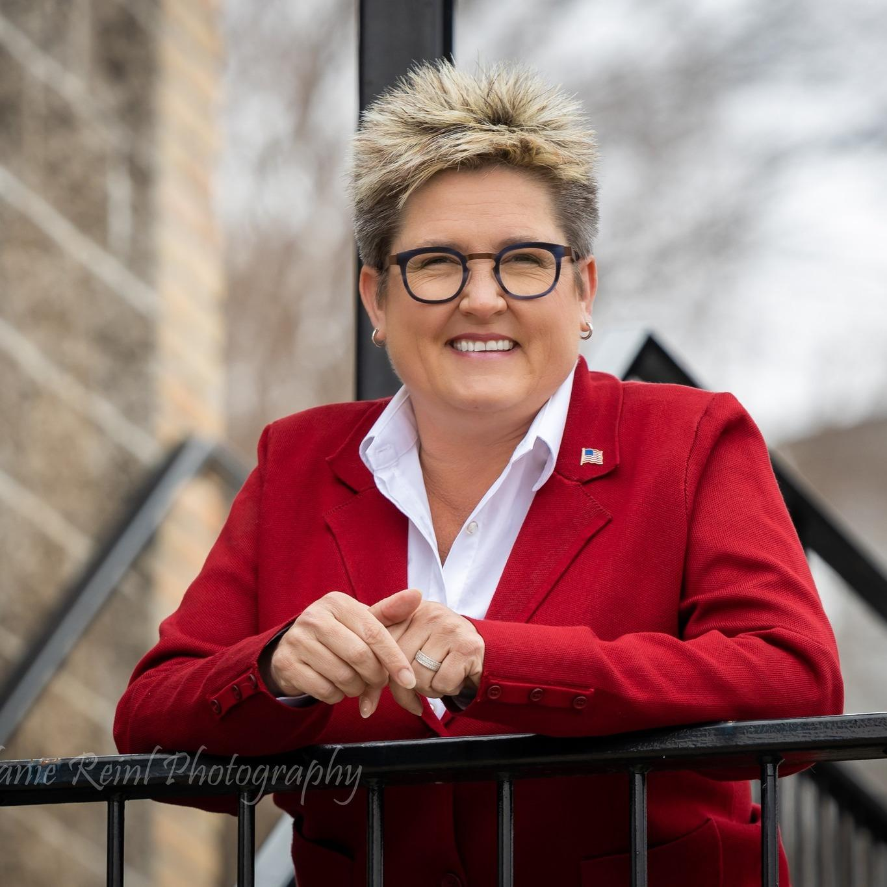
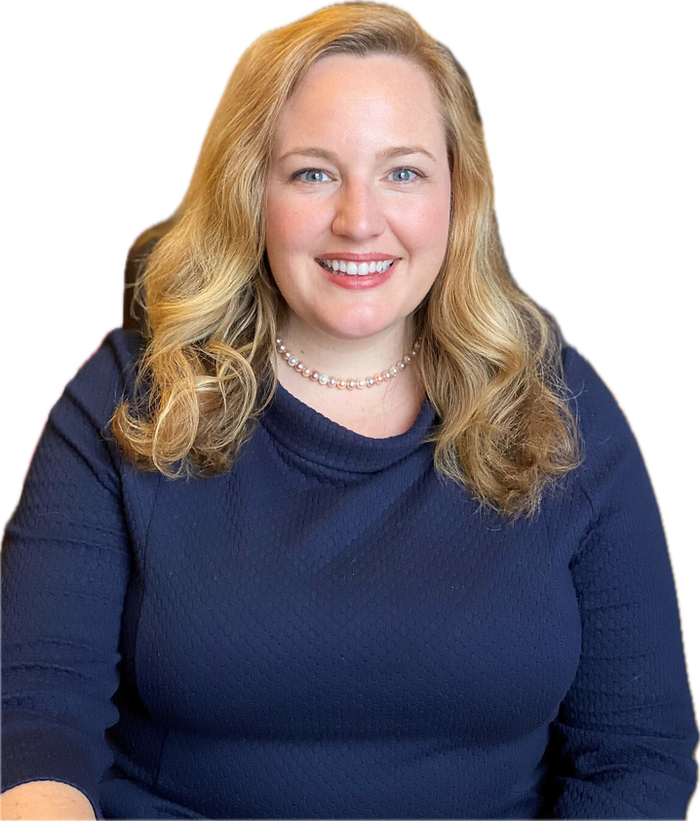
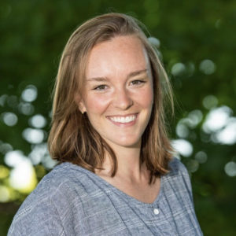
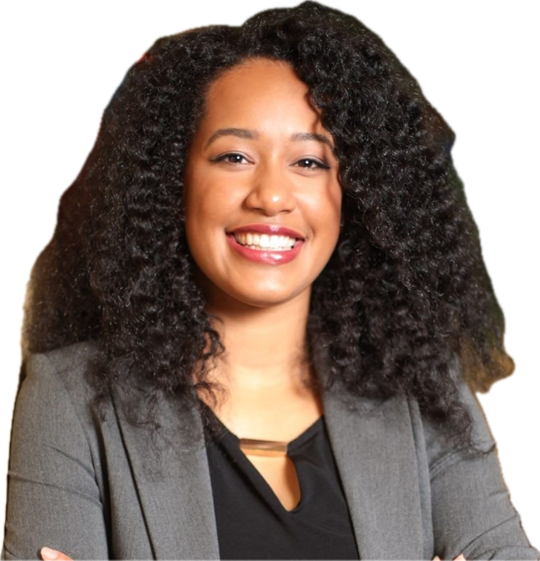
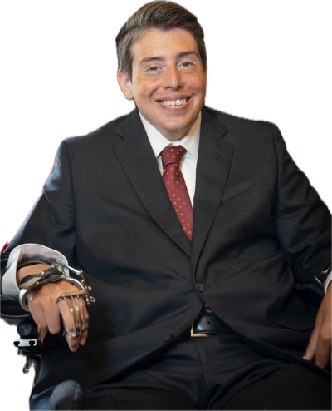
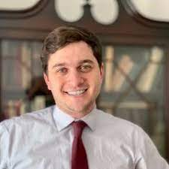
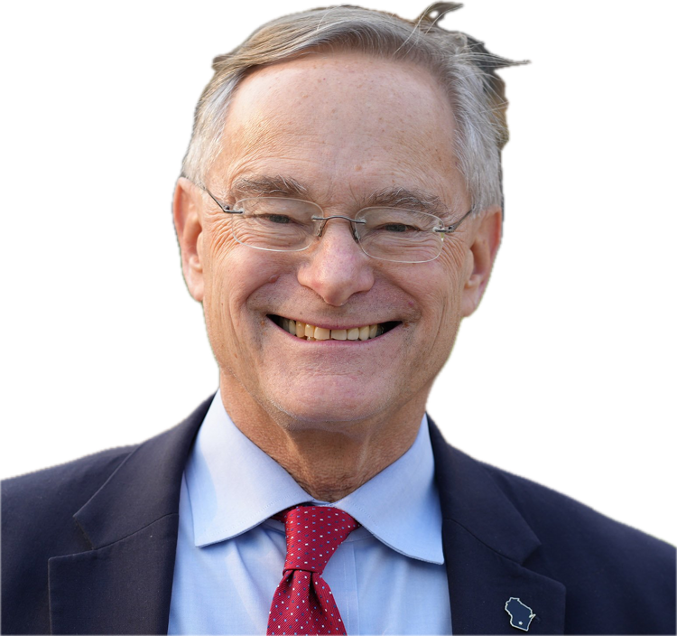
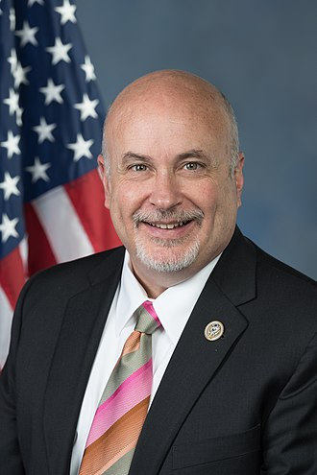
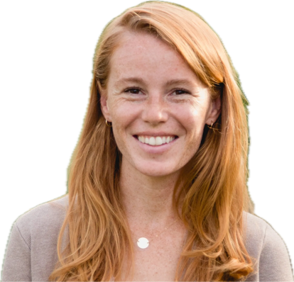
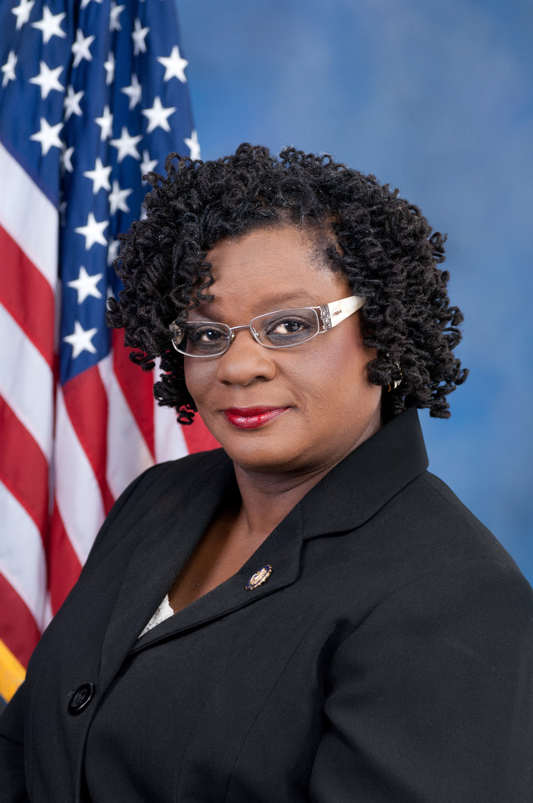
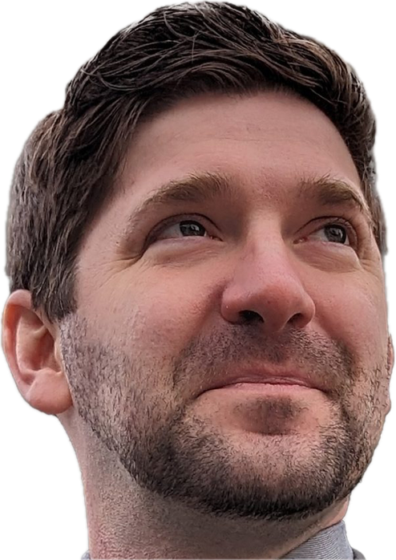
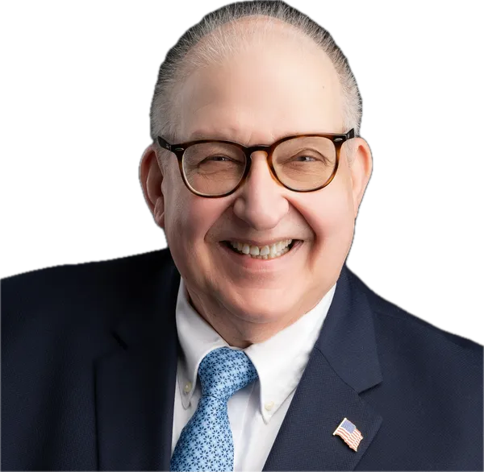
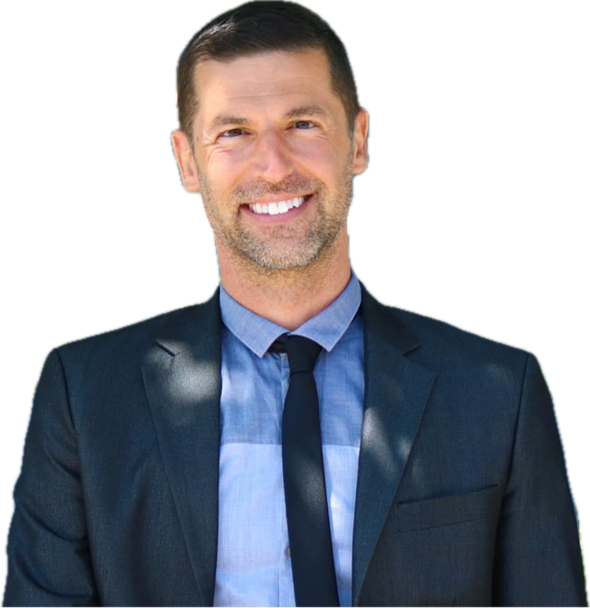
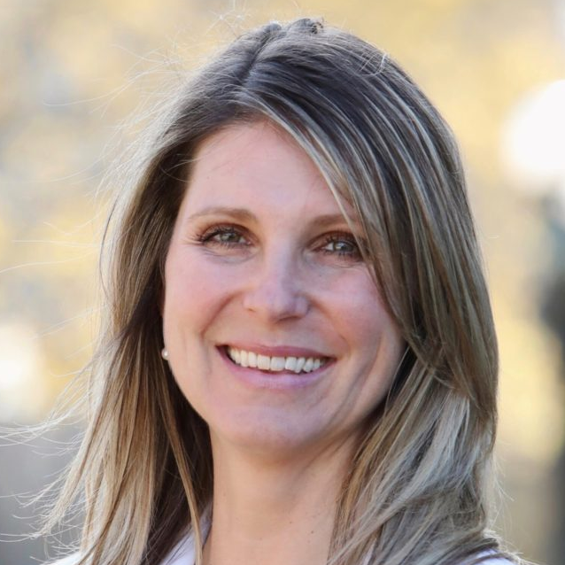
We Have An Amazing Slate of Candidates at Every Level
U.S. Congress Candidates
1st Peter Barca
2nd Mark Pocan*
3rd Rebecca Cooke
4th Gwen Moore*
5th Ben Steinhoff
6th John Zarbano
7th Kyle Kilbourn
8th Kristin Lyerly
Notes:
KEY IDEA:
We have an amazing slate of candidates at every level – that includes house candidates in every district, and state senate & assembly candidates all across the state.

Slide 7
But make no mistake.
We are the underdogs.
Donald Trump has more support and a higher favorability than at any point since 2020. His base is motivated too.
In 2020, the race came down to 20,682 votes in Wisconsin.
Our internal polling shows the race is currently tied.
It is up to our team to get our candidates over the finish line.
Notes:
KEY IDEA:
But we are still the underdogs in this race.
We have every expectation that this will be another nail-biter.

Slide 8
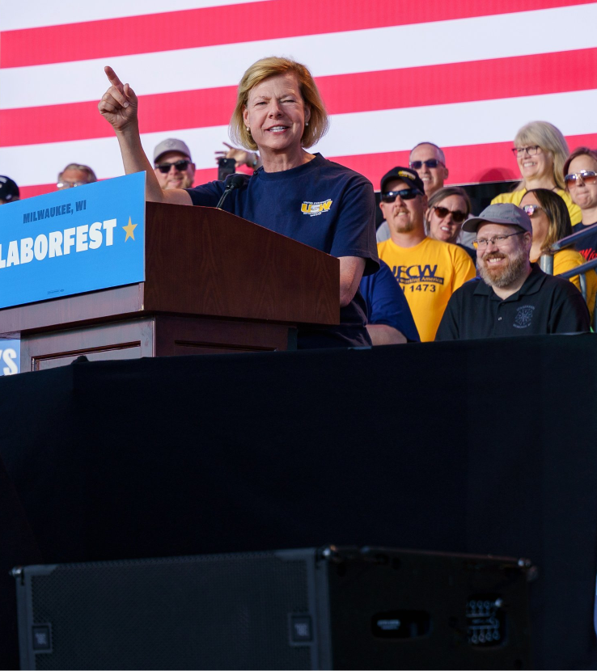
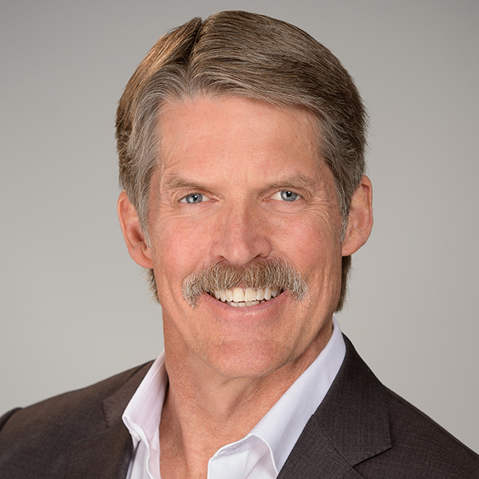
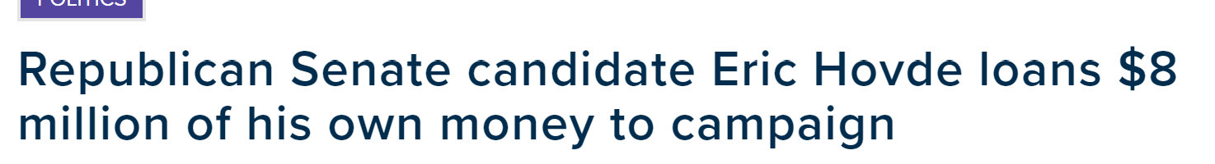
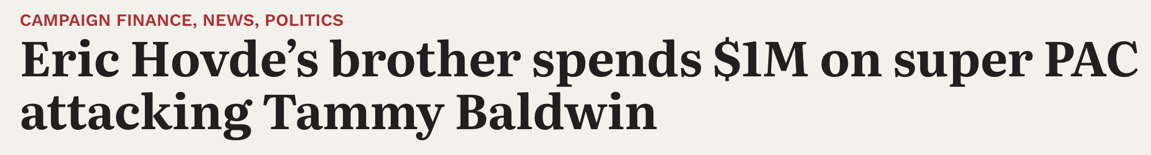
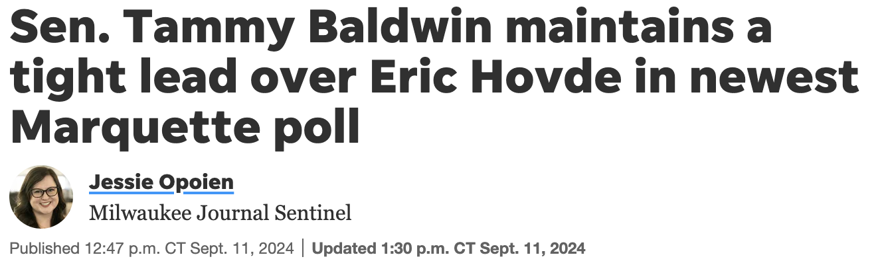
A Tight Senate Race
Senator Tammy Baldwin is committed to making sure that Wisconsin families, not just corporate special interests or the super wealthy, have someone working hard for them.
Eric Hovde is a California millionaire. He will pour millions of dollars into this race.
The US Senate race is within the margin of error.
It is up to our work to make sure we keep Tammy Baldwin in the Senate.
Notes:
KEY IDEA:
Tammy Baldwin is an excellent senator.
Her candidate is spending gobs of money.
We have every expectation this will be tight.

Slide 9
A Track Record of Close Elections
2016
HRC lost by 22,748 votes (0.77%) 3 votes per ward
2018
Evers won by 29,227 votes (1.1%) 4 votes per ward Josh Kaul won by 17,190 votes (0.6%) 2.5 votes per ward
2020
Biden won by 20,682 votes (0.63%) 3 votes per ward
2022
Barnes lost by 26,718 votes (1.0%) 4 votes per ward
Notes:
KEY IDEA: Elections in WI are routinely decided by just a handful of votes. That means this is exactly the kind of election in which every phone call, every door-knock, every shift, every volunteer, could make the difference.

Slide 10
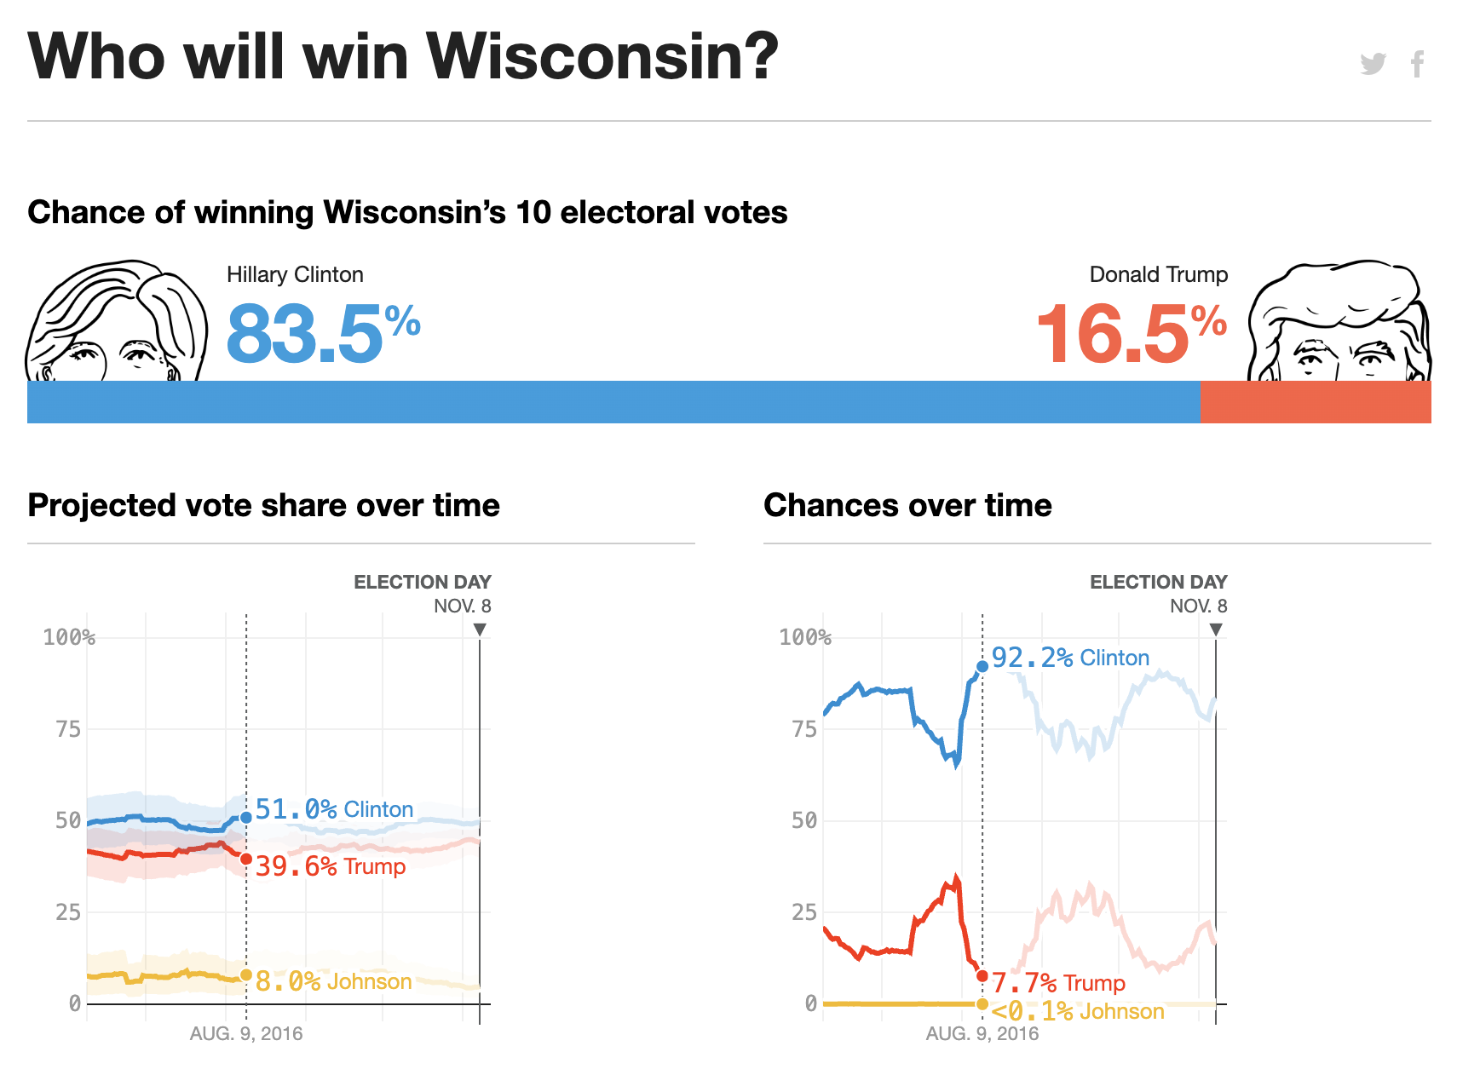

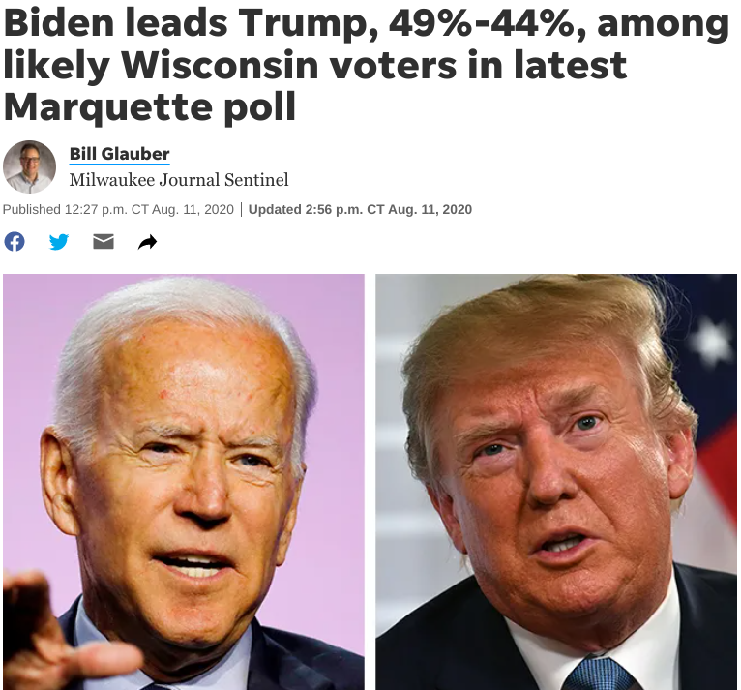

A Word of Caution:
Don’t ride the pollercoaster.
HRC lost by 22,748 votes (0.77%)
Biden won by 20,682 votes (0.63%)
Notes:
KEY IDEA:
Don’t trust polls, and don’t count on vibes – we’ve seen that story before.
FOCUS ON CONTROLLING WHAT YOU CAN CONTROL.

Slide 11
Scaling: The Way We Win

Slide 12
Our Strategy
To succeed, we have to do it all:
Put in the work for Democrats up and down the ballot.
Expand our coalition.
Limit losses in rural areas.
Increase margins in suburban counties.
Run up the score in Dane County & Milwaukee County.
President
Senate
Congress
State Leg.
Notes:
KEY IDEA: We have multiple strategic imperatives, and we have to accomplish all of them to win.

Slide 13
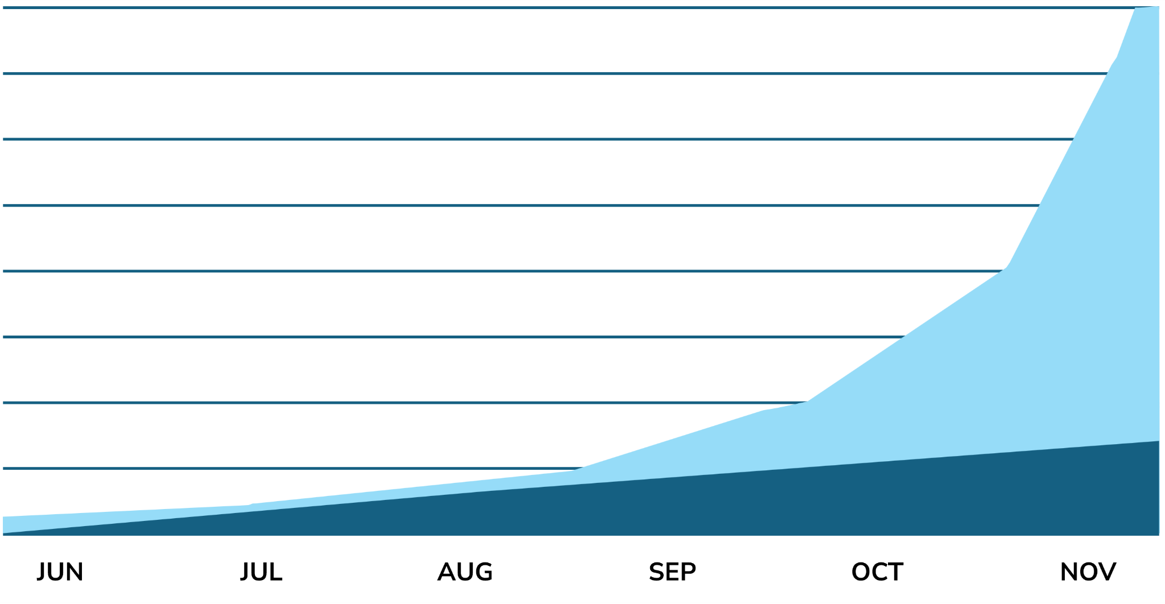

Building Capacity:
The only way to reach all the voters we need to win.
Voters we’ll reach if we maximize volunteer engagement.
Voters we’ll reach if we go it alone.
13
Go to mobilize.us/wisdems/ to find events near you!
Notes:
KEY IDEA: We have A LOT of voters to talk to. We can’t reach them all on our own. Our Volunteer Teams increase our capacity and reach into communities we need to reach.

Slide 14
Building Capacity:
The only way to reach all the voters we need to win.
We need to recruit and onboard NEW volunteers in order to reach all the voters we need to win.
We need Volunteer Leaders to oversee and execute GOTV operations in their turfs, including training the influx of new volunteers.
Notes:
KEY IDEA (same as what’s on the slide):
We need to recruit New Volunteers in order to reach all the voters we need to win.
We need Volunteer Leaders to oversee and execute GOTV operations in their turfs, including training the influx of new volunteers.

Slide 15
Phases of GOTV

Slide 16
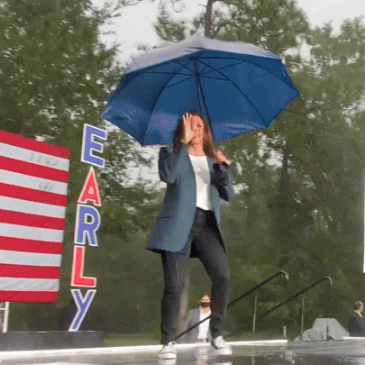
NOW:
Absentee Ballots have been sent and people are voting by mail.
(VBM)
SOON:
Early Vote in Person begins October 22nd
(EVIP)
FINALLY:
Election Day is Tuesday, November 5th
(GOTV)
KEY TO OUR STRATEGY:
The more people we can get to vote early…
…the more efficient we’ll be with our GOTV efforts.
16
Go to mobilize.us/wisdems/ to find events near you!
Notes:
KEY IDEAS:
Our entire campaign builds to Early Vote and GOTV
VBM, EVIP & Election Day voting are all crucial voting methods.
The more people we can get to vote early, the more efficient we can be with our GOTV efforts in the final days.

Slide 17
Absentee Ballots
Vote by Mail Chase
Equip voters who are choosing to vote by mail with the information they need to make their voice heard
Make a plan with voters to return their ballots ASAP
5 checks for success
Have final persuasion conversations with voters who have their ballots
Cure any ballots that are at risk of rejection
Use relational organizing to maximize our efforts!
17
Go to mobilize.us/wisdems/ to find events near you!
Notes:
KEY IDEA: This is what we’re focused on in relation to absentee ballots.

Slide 18
Early Vote In-Person
Push People to the Polls
Get AS MANY FOLKS AS POSSIBLE in our GOTV universe to vote early.
Make plans to early vote
Continue to recruit and onboard volunteers
Ask our voters to get their friends and family to vote early.
“Vote Tripling”
Use wisdems.org/early to help voters find their Early Vote Locations
Dates and times vary by municipality
18
Go to mobilize.us/wisdems/ to find events near you!
Notes:
KEY IDEA: Once early voting in person begins, these are the things we’re focused on.

Slide 19
Election Day + Three Days Beforehand
GOTV: Turn out Our Voters
GOTV is the last four days of the election. These are the final hours we have to talk to voters and empower them to make their voices heard in this election.
Talk to as many voters as possible at the doors and on the phone.
Have effective “vote planning” conversations.
Ask our voters to get their friends and family to vote.
“Vote Tripling” & Relational Organizing
19
Go to mobilize.us/wisdems/ to find events near you!
Notes:
KEY IDEA:
True “GOTV” is the last four days of the campaign.
These are the final hours we have to talk to voters and empower them to make their voices heard in this election.

Slide 20
Data Operation & The Persuasion Universe

Slide 21
DVC Phases of the Campaign in Previous Cycles:
July
Aug
Sept
Oct
Nov
W1
W2
W3
W4
W1
W2
W3
W4
W1
W2
W3
W4
W1
W2
W3
W4
W1
W2
W3
W4
Conventional Persuasion
Persuade to Participate
GOTV (Mobilization)
Ballot Chase*
*Ballot chase will fall in with our normal EVIP/ GOTV universe around October 18th
Notes:
KEY IDEA: This is the old way. In previous cycles we had a hard stop on persuasion at the end of september. We’re not doing that this time.

Slide 22
We will be persuading and mobilizing voters at the same time until the final few days of the election.
KEY TO OUR STRATEGY:
Notes:
KEY IDEA:
Persuasion is usually interpreted to just mean talking to swing-y voters and then hitting up Democratic voters for GOTV
We are going beyond that this cycle.
We will be persuading and mobilizing voters at the same time until the final few days of the election.
DATA DETAILS:
In August we refreshed the persuasion universe using a new persuasion score that models how likely someone is to be swayed about voting for a Democrat in 2022 by hearing from campaigns. This includes people who could be moved to support us if they hear from us, as well as people who could move away from us if they hear only from Republican campaigns. These are the most efficient persuasion targets we can talk to.
This score ranks every voter by how persuadable we think they may be, based on how similar voters responded to messaging for and against Democrats in polling.
Specific parameters: top 50% of persuasion scorers with support 40+ and turnout above 10. We also add in anyone in the same household with a support score above 55 and turnout above 10.

Slide 23
This Year: DVC Phases of the Campaign
Sept
Oct
Nov
W1
W2
W3
W4
W1
W2
W3
W4
W1
W2
W3
W4
Persuasion Proper
Final Stretch Persuasion
Early Vote
GOTV
Conventional Persuasion
Persuade to Participate
Ballot Chase*
*Ballot chase will fall in with our normal Early Vote/ GOTV universe around October 22nd
Notes:
KEY IDEAS:
Now let’s look at what the plan is for our universes.
We are currently in the “Persuasion Proper” phase.
Click to reveal “Conventional Persuasion” block.
Conventional Persuasion will run longer than usual
Black box: Part of the universe will fall out to avoid backlash.
Click to reveal “Persuade to Participate” block.
We have three weeks left in our persuasion phase, and then we are switching our universe to a greater focus on mobilization
This is because as we get closer to the election and as people start voting, the cost of accidentally talking to Republicans increases because we could be reminding our opponent’s voters to show up and vote: whereas the risk is much smaller in the summer because of the wait until the election
Persuasion Definitions:
Conventional Persuasion: Convincing people to vote for our candidates.
Persuade to Participate: Convincing low-propensity voters to vote.
Persuade to Participate universe has some overlap with GOTV targets.

Slide 24
Likely to Vote
OUR BASE VOTERS
VOLUNTEER RECRUITMENT
STRONG GOP VOTERS
DO NOT CONTACT
LIKELIHOOD TO VOTE
PERSUASION
UNIVERSE
Not Likely to Vote
Strong Trump
Undecided
Strong Harris
SUPPORT
Notes:
KEY IDEA: This is our standard persuasion universe, as it has been.
NOTE: You probably don’t need to review this in detail, but the explanation is below.
FACILITATION SCRIPT:
[Persuasion Universe Chart]
This is a visualization of our Persuasion Universe.
The Y axis shows Likelihood to Vote.
The X axis shows their Support Score, meaning how likely they are to support our candidates.
So here’s what this chart shows:
People who are strong GOP voters regardless of their likelihood of voting, we are not trying to persuade. And we definitely don’t want to increase their likelihood of voting.
People who are strong Democrat supporters with a high likelihood of voting, we consider our base and not part of our persuasion universe, and those people are more likely to be contacted for volunteer recruitment.
The L-shaped middle area is the persuasion universe.
KEY POINTS:
The persuasion universe contains a blend of support levels and likelihood of voting.
When you encounter someone in the STRONG GOP or STRONG DEMOCRAT areas, that’s still crucial data for the campaign. Then we’ll know who to avoid in the future and who to attempt to recruit to volunteer.
The persuasion universe is not fixed in stone. It will evolve over time based on campaign strategy and the data that we gather through director voter contact like canvassing and phone banks.
TRANSITION
You don’t need to get hung up on trying to determine which mold someone fits into. Again, it’s not a clear distinction and not an either/or proposition. The Persuasion Mindset and Moves we’re going to teach you apply to all kinds of conversations.

Slide 25
Likely to Vote
OUR BASE VOTERS
VOLUNTEER RECRUITMENT
CONVENTIONAL
PERSUASION
STRONG GOP VOTERS
DO NOT CONTACT
LIKELIHOOD TO VOTE
PERSUADE TO PARTICIPATE
Not Likely to Vote
Strong Trump
Undecided
Strong Harris
SUPPORT
Notes:
KEY POINTS:
As we get closer to Election Day, the persuasion universe will change and become more focused.
We will have a specific subset of persuasion universe targets we will be talking to in the final stretch of the campaign
These targets are designed to prevent backlash (meaning turning out low propensity GOP voters).
Persuading our targeted voters will be key to our path to victory - we need to present them with strong closing arguments.

Slide 26
Likely to Vote
OUR BASE VOTERS
VOLUNTEER RECRUITMENT
GOT(E)V UNIVERSE
(PERSUASION)
STRONG GOP VOTERS
DO NOT CONTACT
LIKELIHOOD TO VOTE
GOT(E)V UNIVERSE
(MOBILIZATION)
Not Likely to Vote
Strong Trump
Undecided
Strong Harris
SUPPORT
Notes:
KEY POINTS:
We will continue to have a focused persuasion universe during GOT(E)V.

Slide 27
Likely to Vote
OUR BASE VOTERS
VOLUNTEER RECRUITMENT
STRONG GOP VOTERS
DO NOT CONTACT
LIKELIHOOD TO VOTE
GOTV UNIVERSE
(MOBILIZATION)
Not Likely to Vote
Strong Trump
Undecided
Strong Harris
SUPPORT
Notes:
KEY POINTS:
For GOTV (final 4 days), the Persuasion targets will fall out of the universe.

Slide 28
GOTV Voter Contact

Slide 29
Voter contact works!
Talking to a voter in the final four days of an election increases their likelihood to vote by 10%, if we have the right kind of conversations.
A GOTV conversation with a voter is effective for up to two weeks, so we need to do a lot of work in a short period of time.
Notes:
KEY IDEA: Voter contact works if we have the right kind of conversations.

Slide 30
Scripts in the final stretch will have a few key elements:
Ask who they’re supporting. Confirm support for Dems up & down the ticket.
Persuade as necessary. Conventional persuasion & persuade to participate.
Vote Planning Language Help voters make a plan to vote.
Maximize each supporter’s impact.
Vote Tripling
Volunteer ask
Notes:
KEY IDEA: The scripts we use in the final stretch will have a few key elements:
Ask who they’re supporting.
Persuade as necessary.
Vote Planning Language
Maximize each supporter’s impact.

Slide 31
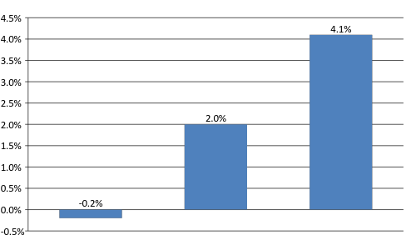

Vote Planning Language Works
Increase in turnout for contacted voters:
Old-fashioned
GOTV *
“Can we count on your vote?”
Making a plan
Notes:
KEY IDEA:
“Old-fashioned GOTV messaging”: Voting language along the lines of “no one is going to vote in the election and you are the only one who is going to vote” has been proven to reduce turnout.
Helping a voter make a plan to vote has been shown to increase their likelihood of voting.

Slide 32

PERSUASION MOVE:
Vote Planning
Components of a Plan to Vote:
Bonus Tactics:
Use the psychology of social proof: Emphasize that turnout will be high and the race will be close. Humans tend to follow the pack.
Where?
Confirm their polling location for them, and make sure they know where it is.
When?
Will they vote early, either by mail or in-person? Will they vote before work, or after work?
Ask them to encourage others to vote, for instance by bringing someone with them or posting on social media.
How?
Get them thinking through the logistics. How will they get to the polls? Where will they be coming from?
Use the psychology of commitment: Ask them whether they commit to vote, and then thank them for their commitment. People think voting is good, and everyone wants to believe they’re a good person.
Research has shown these questions can increase likelihood of voting by 4.1%*
Notes:
FACILITATION SCRIPT
Vote Planning
Vote Planning is an effective technique for nudging someone who says they intend to vote to follow through on that intention. Talking through their plan with you — out loud — helps them visualize the experience, which increases their likelihood to vote. It’s simple, effective, and actually something that many voters find helpful.
When to use it:
Use Vote Planning when you’re sure this person is going to vote for our candidates. Even if they’re a strong supporter, they might not have thought through the logistics or have everything the need to vote.
Here’s how it works:
The three main components of a plan to vote are Where, When and How.
Where?
Confirm their polling location for them, and make sure they know where it is.
When?
Will they vote early, either by mail or in-person? Will they vote before work, or after work?
How?
Get them thinking through the logistics. How will they get to the polls? Where will they be coming from?
There are a few bonus tactics you can use as well:
Use the psychology of social proof: Emphasize that turnout will be high and the race will be close. Humans tend to follow the pack.
Ask them to encourage others to vote, for instance by bringing someone with them or posting on social media.
Use the psychology of commitment: Ask them whether they commit to vote, and then thank them for their commitment. People think voting is good, and everyone wants to believe they’re a good person.
*Citation: Research has shown these questions can increase likelihood of voting by 4.1%
https://scholar.harvard.edu/sites/scholar.harvard.edu/files/todd_rogers/files/do_you_have_a_voting_plan_0.pdf

Slide 33
Confirm Support’
[The first thing you will do is confirm the voter’s support.]
[If Strong Support or Lean Support, move to GOTV Make a Plan]
[If Undecided, speak from the heart and see talking points section below]
[If Strong Opposition or Lean Opposition, politely end the conversation e.g. Thank you for your time.]
GOTV Make A Plan
Great! It’s time to vote and official records show that you are a regular voter. Thank you for being a reliable voter and the type of person who sets a good example for your community!
There’s so much at stake in this election - we want to make sure you have all the information you need. You can vote early in person starting Tuesday, October 22nd. Which day works best for you to vote?
Notes:
KEY IDEA: Just reviewing the script in detail.

Slide 34
GOTV Make A Plan
[If Early Voting] Great! Voting early is an easy and convenient option. Do you know where your nearest early voting location is? [Refer to wisdems.org/early to confirm]
● What time will you go vote? Do you think you’ll go in the morning, around lunch, or maybe in the evening?
● Voting is open at your early voting location between TIME and TIME on DATE.
● How will you get there? Will you walk, drive, or take public transportation?
● Will you bring others with you?
[If E-Day] Great! Do you know where your polling place is? [Refer to myvote.wi.gov to confirm]
● What time will you go vote? Do you think you’ll go in the morning, around lunch, or maybe in the evening?
● Polls are open on Election Day between 7am and 8pm.
● How will you get there? Will you walk, drive, or take public transportation?
● Will you bring other supporters with you?
Remember, you’ll need to bring a photo ID with you to vote. Do you know which type of ID you’ll bring? You can see a full list of acceptable IDs at bringit.wi.gov.
We’re expecting record turnout in this close election - if you have any questions, you can call 608-336-3232 or visit myvote.wi.gov
Notes:
KEY IDEA: Just reviewing the script in detail.

Slide 35

Important Voting Resources:
Find Early Vote Locations: wisdems.org/early
Find Polling Locations: myvote.wi.gov
Voter Assistance Hotline: 608-336-3232
Coming Soon!
There will be a wisdems.org/early 2.0 version of the website coming before EVIP!
Notes:
KEY IDEA: Quick sidebar on some important voting resources.

Slide 36
Volunteer Ask
[If they are a supporter] Thank you for your support. As you know, this is going to be a really important and incredibly close election. We are counting on supporters like you to volunteer and make sure everyone gets out to vote this fall.
We are knocking on doors on [DATE, TIME] and all day on weekends. When would work best for you to join us to help make sure we elect Democrats?
Vote Tripling’
One last question. Can we count on you to remind 3 friends to get out to vote?
Yes No Maybe/ Unsure
[If they say yes to Vote Tripling] Fantastic. We’d love to send you a text message reminding you to reach out to these friends. What’s your cell phone number?
Excellent. To make your text message specific, we’ll include the first names of the three friends you’ll remind. What are their first names?
Notes:
KEY IDEA: Just reviewing the script in detail.

Slide 37
Staging Locations

Slide 38
GOTV: The final four day in action:
Staging Locations are ready across the state with all of the materials they need.
Staging Location Leaders are at their stations, ready to launch DVC shifts.
Canvassing shifts launch at 9am, 12pm, 3pm, and 6pm.
Statewide phone banking shifts launch at 10am, 12pm, 2pm, 4pm and 6pm.
Community-led relational shifts are happening across the state.
This is what we’ve been building towards: more meaningful conversations with voters than ever before.
Go to mobilize.us/wisdems/ to find events near you!
Notes:
KEY IDEA: During GOTV, all our efforts rely on volunteer-run Staging Locations. We’re going to talk about these in detail now.
During the final four days:
Staging Locations are ready across the state with all of the materials they need.
Staging Location Leaders are at their stations, ready to launch DVC shifts.
Canvassing shifts launch at 9am, 12pm, 3pm, and 6pm.
Statewide phone banking shifts launch at 10am, 12pm, 2pm, 4pm and 6pm.
Community-led relational shifts are happening across the state.

Slide 39
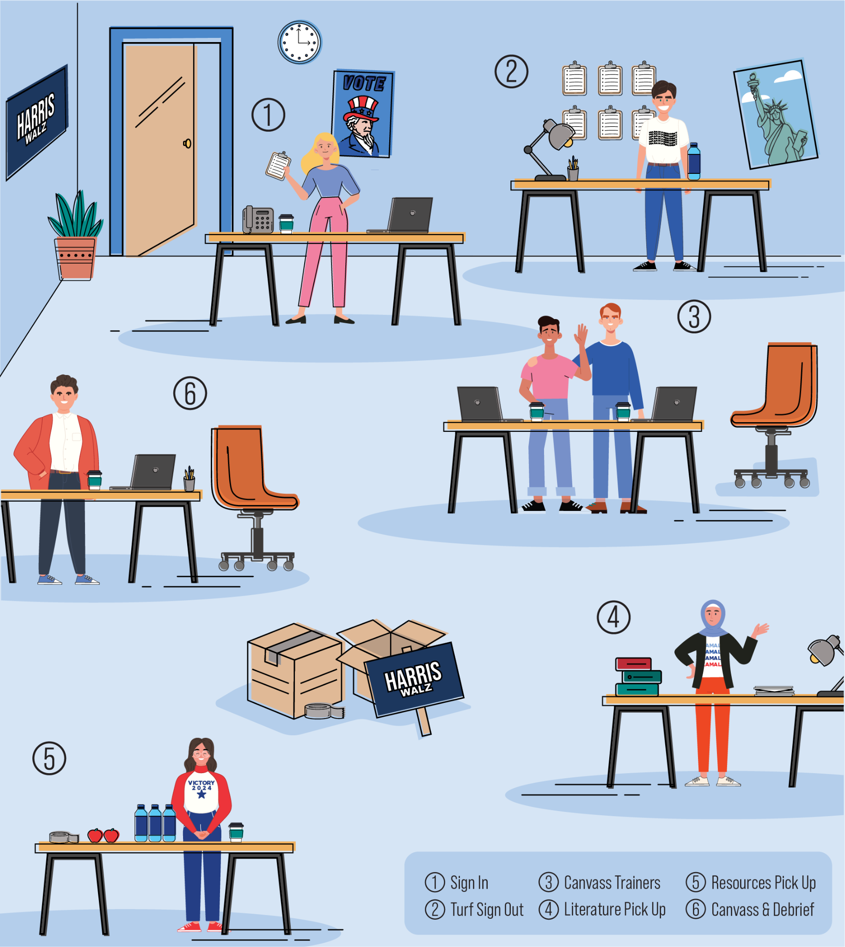
What is a Staging Location?
A staging location is a space where volunteers are trained & empowered to do DVC during GOTV.
Staging Locations allow us to minimize travel time, maximize DVC time and volunteer capacity.
Notes:
KEY IDEA: See slide text.

Slide 40
What is a Staging Location?
There are different kinds of Staging Locations depending on what kind of DVC the location is focused on.
Canvassing SLs
Focus on knocking doors.
May also focus on Relational Outreach & High Traffic Canvassing, including launching HTC shifts, hosting Relational shifts, and providing additional trainings around these topics.
Virtual Staging Locations:
Run by a distributed team
Focus on phone calls.
Notes:
KEY IDEA: See slide text.

Slide 41
Why are Staging Locations so important?
We need a lot of locations and a full roster of SL Leaders to be successful.
Lets us get closer to targeted voters.
Increases efficiency.
Enables us to handle the high volume of GOTV volunteers.
Frees up Organizers to do DVC (since they’re some of our best messengers.)
Notes:
KEY IDEA: See slide text.

Slide 42
Key Features of a Staging Location
Consistently Available–for WOAs, GOT(E)V and GOTV
Easy to find
Spacious
Flow in a logical way
WiFi Accessibility
ADA Accessible
Consistent leadership throughout
Notes:
KEY IDEA: See slide text.

Slide 43
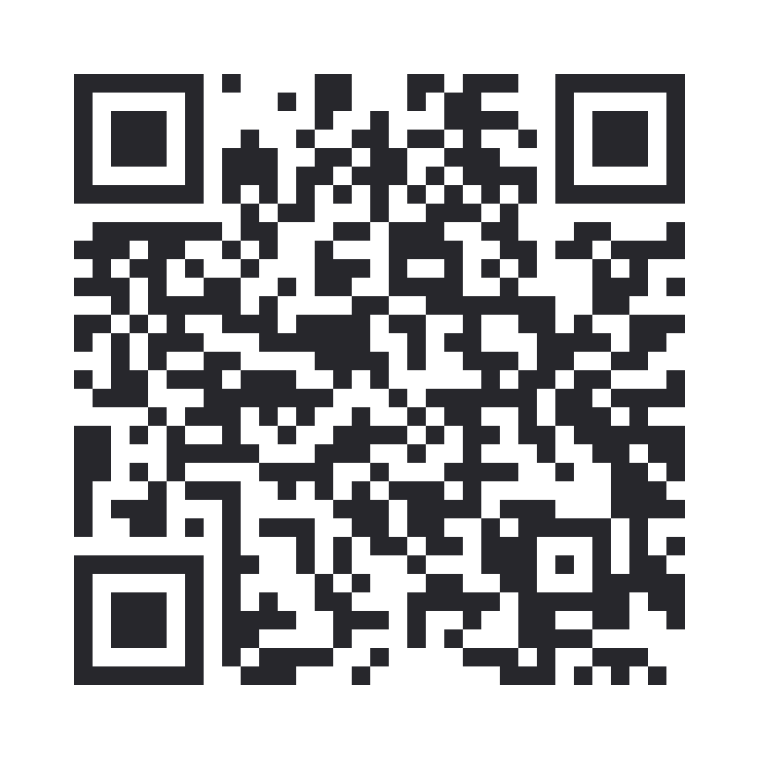
We also offer a digital training that explains Staging Locations:
Notes:
KEY IDEA: We also made a crash course on Staging Locations that covers everything we’re talking about here.

Slide 44





Staging Location Leadership Roles
The number of leaders will depend on your location, but in general an effective staging location needs:
Turf Captain*
Confirm & Debrief Captain
Sign-in & Reshift Captain
Canvass Captain
Staging Location Director
We will provide ample training for everyone who steps up to take on a Staging Location Leadership role.
Notes:
KEY IDEA:
These are the core roles of a staging location. We will provide ample training for everyone who steps up to take on a Staging Location Leadership role.
This includes optional role-specific trainings over Zoom offered throughout October.
GOTV Training Workshops for SL Leaders will be offered throughout the month of October.
MOBILIZE LINKS:
Staging Location Directors
Canvass Captains
Sign-In Captains & Confirm Captains
Turf Tracker Deep-Dive

Slide 45
Staging Location Director
Role & Responsibilities:
Keeps the staging location running on time - follow the tick tock and ensure other leadership does as well
Their primary role is reporting accurately & on-time
Manages the operation of the staging location
Collects info from the captains and reports up to the regional boiler room
Qualities:
Consistent
Adaptable
Organized
A Team Player
Calm under pressure
Responsive
Anything else?
Notes:
KEY IDEA: Review SLD role.

Slide 46
Canvass Captain
Role & Responsibilities:
Oversees the whole canvass training operation of the location.
Trains & Supports Canvassers:
Verbally go over script, in particular MAKE A PLAN language
Go over expectations surrounding packet
Give their number out to canvassers to call if they run into problems
Reports number of canvassers and packets out to SLD.
Qualities:
Clear Communicator
Friendly
Adaptable
Responsive
Anything else?
Notes:
KEY IDEA: Review Canvass Captain role.

Slide 47
Sign-In & Reshift Captain
Role & Responsibilities:
Greets & signs volunteers into the Staging Location.
Their main focus is reshifting volunteers & making sure the location runs smoothly
Directs volunteers to where they should go next.
Keeps the location organized!
Can be a flexible role to fill in other positions as needed.
Qualities:
Friendly
Strong Hard Ask
Organized
Adaptable
Persistent
Responsive
Anything else?
Notes:
KEY IDEA: Review Sign-In & Reshift Captain role.

Slide 48
Confirm & Debrief Captain
Role & Responsibilities:
Responsible for making confirm calls (same day and next day) and flake chase calls for the Staging Location.
Ensures volunteers scheduled have all the info they need to complete their shift.
Debriefs canvassers following their shift and reshifts them for future shifts.
This person needs to have a good hard ask and be persistent.
Qualities:
Friendly
Strong Hard Ask
Organized
Adaptable
Persistent
Responsive
Anything else?
Notes:
KEY IDEA: Review Confirm & Debrief Captain role.

Slide 49
Turf Captain
Role & Responsibilities:
Responsible for organizing and distributing turf to volunteers.
This position is a must have for large Staging Locations and a nice to have for smaller Staging Locations.
Qualities:
Organized
Adaptable
Persistent
Responsive
Anything else?
Notes:
KEY IDEA: Review Turf Captain role.

Slide 50
Additional “Nice to have” Staging Location Roles
Data Captain Responsible for entering data from paper walk packets, closing shifts, scheduling new reshifts in VAN etc.
Additional Canvassing Trainers & Sign In Leaders In large Staging Locations, you might need multiple canvassing trainers & sign in leaders to run an effective staging location flow & training.
Relational Captain Responsible for training and overseeing Relational Organizing shifts.
Comfort Captain Responsible for making sure all volunteers are well fed and able to perform.
Notes:
KEY IDEA: These are some additional roles that might make sense for your location or your teams.

Slide 51
Reporting: A Key Aspect of Staging Locations
What is reporting?
Why do we report?
Sharing the numbers of:
How many volunteer shifts
How many turfs packets were sent out
How many volunteers are reshifted for a future shift
Status of chase calls & confirm calls
GOTV is important and complex: there is limited time, resources, and capacity.
Following the chain of command is more important during GOTV than ever.
Accurate reporting is crucial to measuring our capacity, our work, and making quick decisions about where to allocate resources.
Notes:
KEY IDEA: During GOTV, Staging Locations will need to report what’s happening at their locations up the ladder of the campaign.
Reporting quickly and accurately allows us to make REAL TIME DECISIONS about capacity and necessary adjustments.
We will likely need to move resources, packets, staff and volunteers based on reports.
For Example: If a flake rate is high in one location but a neighboring location is moving through their packets quickly we can make real time adjustments and move volunteers & packets as needed.

Slide 52
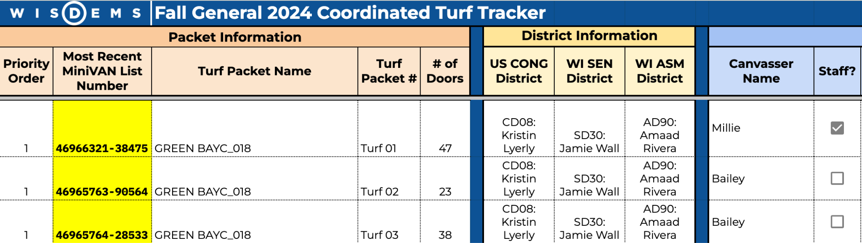
Staging Location Turf Tracker Priority Order
Notes:
KEY IDEA: HQ will cut turf.

Slide 53

The Chain Of Command - Why This Matters:
Information flows up to HQ
This data helps the campaign understand what is happening on the ground & make strategic decisions as a result of this information.
Staging locations should only talk directly to Regional Boiler Rooms, who can help solve any on the ground problems!
Notes:
KEY IDEA (same as slide text):
Information flows up to HQ
This data helps the campaign understand what is happening on the ground & make strategic decisions as a result of this information.
Staging locations should only talk directly to Regional Boiler Rooms, who can help solve any on the ground problems!

Slide 54
The Chain Of Command - Why This Matters:
Directives will flow down to Boiler Rooms and Staging Locations.
We may need to move capacity because we’ll finish our universe in one area or another SL needs more capacity.
This allows us to more efficiently redirect resources, etc.
Notes:
KEY IDEA (same as slide text):
Directives will flow down to Boiler Rooms and Staging Locations.
We may need to move capacity because we’ll finish our universe in one area or another SL needs more capacity.
This allows us to more efficiently redirect resources, etc.

Slide 55
Volunteer Recruitment

Slide 56
GOTV shift goals are based on hard facts.
They are directly correlated to the voters we need in order to win.
Notes:
KEY IDEA: See slide text.

Slide 57
The only way to get the shifts we need is to use our hardest asks and going into recruitment with the right mindset!
Notes:
KEY IDEA: See slide text.

Slide 58
We need YOUR help!
We need THOUSANDS of volunteers to talk to the voters we need to.
Organizers cannot do the volunteer recruitment we need alone.
We need volunteer leaders to help!
YOU are some of the most effective messengers in encouraging other volunteers to get involved.
Notes:
KEY IDEA:
YOU are some of the most effective messengers in encouraging other volunteers to get involved.

Slide 59
3 Things YOU Can Do
Call through active, almost engaged & dropped volunteers in your team turf:
Schedule them for as many shifts as possible now through election day!
Your Team PTGs are great to help you visualize who you have left to schedule.
Host consistent volunteer recruitment phone banks to get new volunteers involved!
Use Relational Organizing to bring in new volunteers for this final stretch!

Slide 60
Consistent Volunteers:
Increase the Urgency of our Asks
Active vols are volunteers who have completed 2 or more action shift in the last 28 days
We are less than 6 weeks out, we need to schedule them for all the shifts!
We need them now more than ever - use your best layered ask!
Reshift them now through Election Day - then empower them to help you recruit more new volunteers.

Slide 61
Less Frequent Volunteers
Increase the Persistence of Asks
“Almost engaged volunteers” are volunteers who have completed 1 action shift or team building shift in the last 28 days.
These are incredible leads and we need to get them scheduled again ASAP. They already took that first leap to getting involved!
When calling, use your best layered ask and schedule for multiple shifts.

Slide 62
Potential New Volunteers
Use Every Tool at Our Disposal
We need to recruit new volunteers – people who have not taken action yet – and motivate them to do something.
Make use of low bar events to get them in the door.
New volunteer leads include:
Vols who have attended non-action events
Friends of Active Vols
Vol Nos, Maybes, Later
Who else can you think of?

Slide 63
What will change about your asks during the Final Stretch?
You’ll be making MORE ASKS than ever before
You’ll asking for MORE THINGS than ever before
You’ll be making BIGGER ASKS than ever before

Slide 64
Tactics & Strategies for Successful Asks
Ask backwards from Election Day.
Asks for multiple packets and multiple people.
Bring THE MOST urgency.
64
Go to mobilize.us/wisdems/ to find events near you!

Slide 65
Start by asking for multiple shifts during Final Four
Ask backwards from Election Day.
Asks for multiple packets and multiple people.
Bring THE MOST urgency.
“We need to get those last voters, who need the most help to make sure they’re voting, out on Election Day. Can you join us at 9 am, 12 pm, 3 pm, or 5 pm?”
“Awesome! Let’s look at our times on November 2, 3 and 4 now.”
65
Go to mobilize.us/wisdems/ to find events near you!

Slide 66
Once you’ve got Final Four covered, ask about GOT(E)V
Ask backwards from Election Day.
Asks for multiple packets and multiple people.
Bring THE MOST urgency.
“Awesome! Our next most important weekends are October 19th and 20th, and October 26th and 27th. Can you join us at the same time on those weekends?”
66
Go to mobilize.us/wisdems/ to find events near you!

Slide 67
Ask volunteers who’ve shown up once or twice before to take out multiple packets.
Ask backwards from Election Day.
Asks for multiple packets and multiple people.
Bring THE MOST urgency.
“We both know you’ve been crushing these packets lately. I know you’re knocking X packets on Saturday of Final Four, and can you add a second packet on weekends in October as well?”
67
Go to mobilize.us/wisdems/ to find events near you!

Slide 68
This is our final push:
It does not get more urgent than this moment.
Ask backwards from Election Day.
Asks for multiple packets and multiple people.
Bring THE MOST urgency.
“We’re down to our last 4 weekends - these are the weeks that matter most. How do you want to feel when you wake up Nov. 6?”
68
Go to mobilize.us/wisdems/ to find events near you!

Slide 69
Wrap-Up & Questions

